Slide 1
RCITI @ UNSW SYDNEY × DEPARTMENT OF TRANSPORT AND PLANNING, VICTORIA
Safe Local Roads and
Streets Program
Risk data products for Victoria's road network — Infrastructure Risk Rating,
Collective Risk and Personal Risk
Capability briefing Prof. Taha Rashidi · Research Centre for Integrated Transport Innovation (rCITI), UNSW Sydney · 30 July 2026
Notes:
Open on the shared goal: SLRSP needs trusted, whole-of-network risk products. rCITI is here as a delivery partner that already lives in these exact datasets and methods. Today: show, not tell — everything you'll see is live work on Victorian data.

Slide 2
WHO YOU'D BE WORKING WITH
A research centre that ships decision-ready data products
rCITI at UNSW Sydney works end-to-end: from raw state datasets to validated, documented, decision-ready platforms. Road-safety risk analytics is a core, active capability for the centre — not a one-off study. The examples in this briefing are live systems built on Victorian data.
Victorian data fluency
Methods that match the manuals
Vicmap TR_ROAD, DTP open data, crash records, SCATS and telematics — handled daily in live projects.
AusRAP / iRAP protocols, Austroads guidance and HSM-aligned evaluation — applied, not just cited.
Delivery-grade engineering
University-based independence
Reproducible pipelines, technical documentation, metadata and handover packages as standard outputs.
Transparent methods with quality flags and caveats the Department can stand behind publicly.
Notes:
Position rCITI as the partner that closes the gap between research quality and delivery. Emphasise: we already work with the exact Victorian datasets this program depends on, and our default outputs are documented, reproducible and auditable.

Slide 3
WHAT THE PROGRAM NEEDS
Three risk products, one curated network
ROAD-ATTRIBUTE DATA · PROACTIVE
CRASH DATA · REACTIVE
CRASH ÷ EXPOSURE
Infrastructure Risk Rating
Collective Risk
Personal Risk
Whole-of-network rating from curated input attributes agreed with the Department — score, band, supporting fields, plus confidence and imputation flags where data is sparse.
FSI and FSI-equivalent crash density — score, bands and rankings, with corridor / midblock and intersection views and documented calculation methods.
Exposure-adjusted crash rate per distance travelled — with AADT inputs carrying explicit source and confidence fields per segment.
Supporting products in scope: curated VicMap TR_ROAD network layer · validated five-year crash summaries · AADT attribution with source & confidence · technical documentation, data dictionaries and a reproducibility & handover package
This briefing is structured around the mandatory data products in the scope.
Notes:
Mirror their scope back to them, in their order: IRR, Collective, Personal, plus the supporting layer. Land the message that we read the scope closely — curated attributes 'proposed by the supplier and agreed by the Department' is exactly how we like to work.

Slide 4
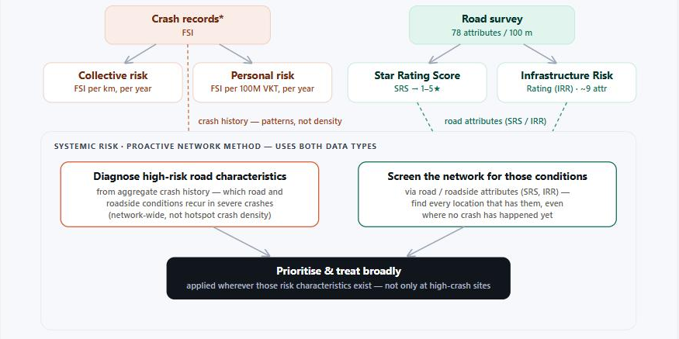
THE FOUNDATION
We know these five measures inside-out — and teach them
Two data lanes, one goal.
Reactive: crash history drives Collective and Personal Risk. Proactive: coded road attributes drive Star Rating and IRR. Keeping the lanes straight is what makes the outputs defensible.
We wrote the explainer.
Our team maintains a public, referenced guide to exactly these five measures — with a live Q&A assistant — used by practitioners to un-confuse them.
Why it matters for SLRSP.
Outputs only change decisions when DTP, TAC and councils can read them with confidence. We bring the literacy layer with the data.
From our published explainer: the road-risk family — crash-based and attribute-based measures, and the systemic method spanning both.
Notes:
This slide earns the right to talk method. The diagram is from our own public explainer of the five measures — collective, personal, star rating, IRR, systemic. If asked, we can walk through why collective vs systemic is the most common mix-up and how IRR is a sibling of star rating, not derived from it.

Slide 5
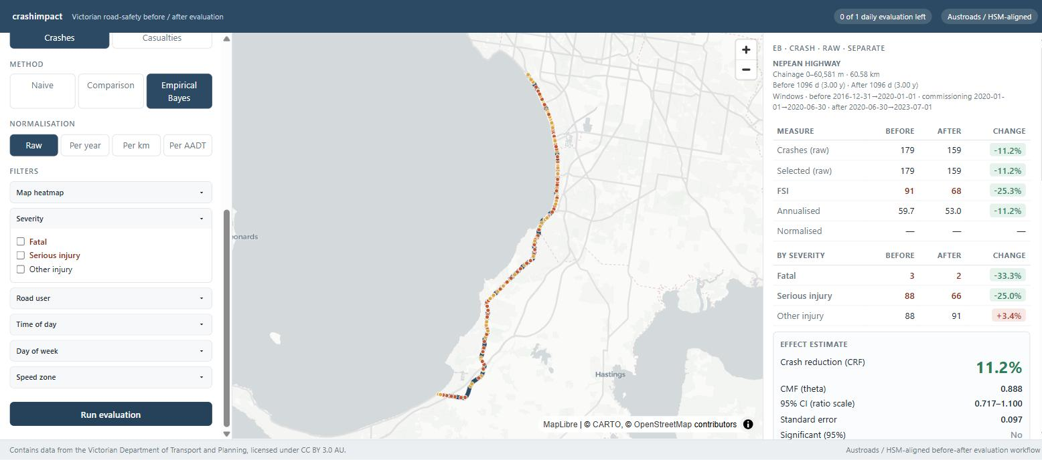
COLLECTIVE & PERSONAL RISK
Crash-risk analytics we've already built for Victoria
Corridor FSI analytics, the DTP way.
Five-year validated crash windows, FSI-equivalent severity weighting, percentile banding, corridor / midblock vs intersection views.
Austroads / HSM-aligned evaluation, live.
A working before-after platform on the full Victorian network: Empirical Bayes with comparison-group and naive baselines, severity and road-user filters, per-AADT normalisation.
Built to be interrogated.
Every estimate ships with its window, method, confidence interval and significance — nothing hides in a spreadsheet.
Live evaluation on a 60 km Victorian arterial — EB effect estimate with confidence intervals, severity split, and method / normalisation controls.
Notes:
The screenshot is a real evaluation run on the Nepean Highway corridor — 60 km, three-year windows either side of a commissioning period, Empirical Bayes effect estimate with CI. Point: the crash-based lane of SLRSP (collective + personal) is delivery, not research risk, for this team.

Slide 6
THE EXPOSURE PROBLEM
Personal Risk lives or dies on AADT — we close that gap
Local roads rarely have traffic counts — yet Personal Risk needs exposure on every segment. Our approach attributes AADT across the entire network with an explicit source and confidence tier on each segment, so low-confidence values are flagged, never hidden.
1
MEASURED
Permanent counters and tube surveys — the ground-truth spine.
~1.27M
2
EXPANDED
SCATS signal detectors calibrated against measured sites.
VicMap TR_ROAD segments statewide
PROBE
Attribution designed for full-network coverage — every segment carries its AADT, its source, and its confidence.
3
Connected-vehicle telematics, penetration-corrected.
4
MODELLED
Network and land-use context inference — envelope-checked against statewide travel totals.
Notes:
The scope explicitly asks for AADT attribution with source and confidence fields — this is a solved problem in our workflow. Four tiers, calibrated downward from ground truth, reconciled against statewide vehicle-kilometre envelopes. We flag uncertainty instead of hiding it, which is what makes Personal Risk on local roads honest.

Slide 7
THE QUESTION YOU ASKED
IRR on local roads: we can source or generate every input
IRR input attribute | How we deliver it for local roads
Road stereotype & seal | VicMap TR_ROAD attributes — class, divided / undivided, lanes, seal, urban–rural
Alignment & curvature | Derived from network geometry, computed statewide
Carriageway width | Imagery- and LiDAR-assisted measurement; modelled where sparse, flagged as such
Roadside hazards (left / right) | Tree-canopy and roadside feature datasets — in active use today for hazardous objects near the carriageway
Land use & access density | Planning-zone layers, cadastre and access inference
Intersection density | Network topology, computed statewide
Traffic volume | Tiered AADT attribution with per-segment source & confidence
Operating speed (desirable scope) | Probe-speed data and speed-limit / operating-speed comparison — already built
Curated inputs, agreed with the Department — every field lands with quality, confidence and imputation flags. And we're open to any dataset you can bring: asset registers, surveys, SCATS, LGA data.
Notes:
This is the direct answer to the data-variables question. As a university centre we know — and usually hold — the best available source for each IRR attribute, and where none exists we generate it and flag it. Highlight the roadside-hazards row: tree datasets are already in active use for hazardous-object proximity. Close with the open-door line: any DTP or LGA dataset improves the curation, and the scope's 'proposed by supplier, agreed by Department' model is exactly our preferred working style.

Slide 8
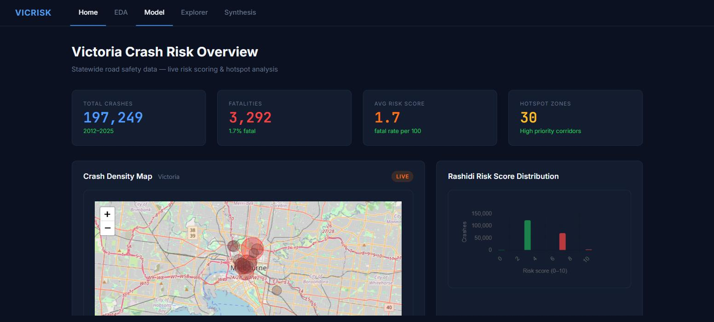
BEYOND THE MINIMUM
Network-wide risk modelling, with QA you can audit
Statewide screening layers.
Machine-learning crash-risk models over the full Victorian open crash record — complementing IRR and crash-risk mapping with pattern-level screening.
Validation as culture.
Holdout testing, envelope reconciliation, documented caveats — data-quality and confidence fields are first-class outputs, exactly as the scope requires.
Reproducible to the end.
Versioned pipelines, data dictionaries and metadata — the reproducibility and handover package is how we work by default.
Statewide risk screening and hotspot analytics built on the Victorian open crash record (2012–2025).
Notes:
Second proof point: statewide ML risk screening on open data — 197k crashes, 2012–2025 — with live scoring and hotspot analytics. The message isn't 'ML for its own sake'; it's that whole-of-network modelling, validation discipline and confidence reporting are routine for us, which de-risks the IRR imputation the scope anticipates.

Slide 9
HOW WE'D WORK WITH YOU
A delivery partnership, not a black box
01
02
03
Confirm inputs together
Deliver in stages
Leave you self-sufficient
Dataset confirmation with the Department at commencement. We identify gaps, limitations and inconsistencies up-front — in writing, before they become surprises.
Curated network layer → exposure → Collective & Personal Risk → IRR. Each stage documented, spot-checkable and usable on its own.
Reproducibility and handover package: your team can re-run, audit and extend every output — with data dictionaries and metadata included.
Prof. Taha Rashidi · Research Centre for Integrated Transport Innovation (rCITI), UNSW Sydney
Notes:
Close on partnership and trust: co-curated inputs (their scope language), staged delivery they can check at every step, and a handover that leaves DTP self-sufficient. Invite the data conversation: the sooner we see candidate input datasets, the sharper our gap analysis for local roads.

